Slide 1

Principles of 2D Image Analysis
Part 3 of 3
Notes prepared by Dr. Bartek Rajwa, Prof. John Turek & Prof. J. Paul Robinson
These slides are intended for use in a lecture series. Copies of the graphics are distributed and students encouraged to take their notes on these graphics. The intent is to have the student NOT try to reproduce the figures, but to LISTEN and UNDERSTAND the material. All material copyright J. Paul Robinson unless otherwise stated, however, the material may be freely used for lectures, tutorials and workshops. It may not be used for any commercial purpose. It is illegal to upload this lecture to CourseHero or any other site.
www.cyto.purdue.edu
UPDATED Jan 2019

Slide 2
Image Processing in the Spatial Domain
Arithmetic and logic operations
Basic gray level transformations on histograms
Spatial filtering
Overview of analytical techniques

Slide 3
Modifying image contrast and brightness
The easiest and most frequent method is histogram manipulation
An 8 bit gray scale image will display 2⁸ =256 different brightness levels ranging from 0 (black) to 255 (white) (2¹⁰=1024, 2¹²=4096). An image that has pixel values throughout the entire range has a large dynamic range, and may or may not display the appropriate contrast for the features of interest. 16 bit would be 2¹⁶ (or 65,536)
(Non-linear enhancements - e.g. Equalization see later)

Slide 4
Image Processing
.... is the procedure of feature enhancement prior to image analysis. Image processing is performed on pixels (smallest unit of digital image data). The various algorithms used in image processing and morphological analysis perform their operations on groups of pixels (3 X 3, 5 X 5, etc.) called kernels. These image processing kernels may also be used as structuring elements for the various image morphological analysis operations.

Slide 5
Basics of Spatial Filtering
The process of spatial filtering consists of moving the filter mask from point to point in an image
At each point the response of the filter at that point is calculated using a predefined relationship

Slide 6
A
B
C
The above figure represents a series of 3 pixel x 3 pixel kernels. Many image processing procedures will perform operations on the central (black) pixel by using use information from neighboring pixels. In kernel A, information from all the neighbors is applied to the central pixel. In kernel B, only the strong neighbors, those pixels vertically or horizontally adjacent, are used. In kernel C, only the weak neighbors, or those diagonally adjacent are used in the processing. It is various permutations of these kernel operations that form the basis for digital image processing.

Slide 7
Spatial filtering
Linear filtering of an image f size M x N with a filter mask of size m x n is given by the expression:

Slide 8
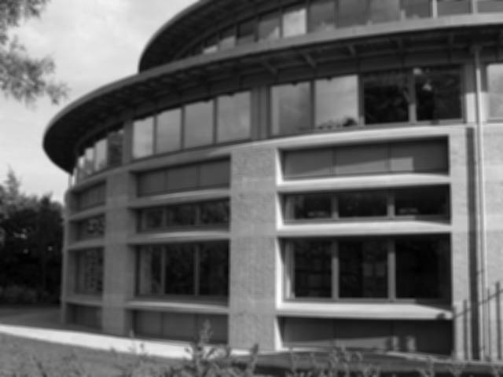

Low-pass filter
1/9 | 1/9 | 1/9
1/9 | 1/9 | 1/9
1/9 | 1/9 | 1/9
A spatial low-pass filter has the effect of passing, or leaving untouched, the low spatial frequency components of the image.
High frequency components are attenuated and are virtually absent in the output image

Slide 9
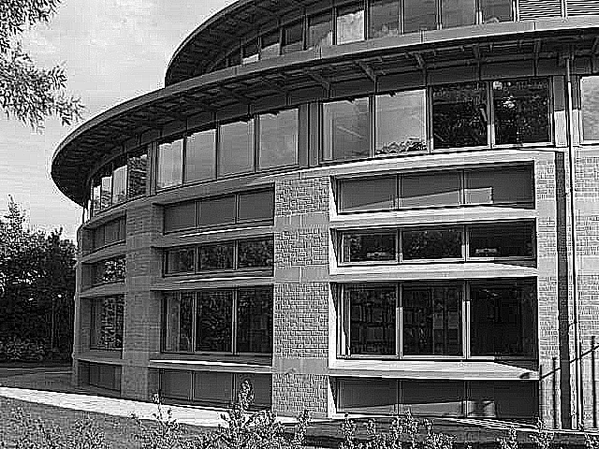
High-Pass Filter
-1 | -1 | -1
-1 | 9 | -1
-1 | -1 | -1
The high pass filter has the opposite effect of the low-pass filter.
It accentuates high frequency spatial components while leaving low frequency components untouched

Slide 10
Edge Detection and Enhancement
Image edge enhancement reduces an image to show only its edges.
Edge enhancements are based on the pixel brightness slope occurring within a group of pixel

Slide 11
Laplacian Edge Enhancement
Laplacian is an omnidirectional operator that highlights all edges in a image regardless of their orientation.
Laplacian is based on the second-order derivative of the image:
Useful for finding directional organelles, structural
components, ETC

Slide 12
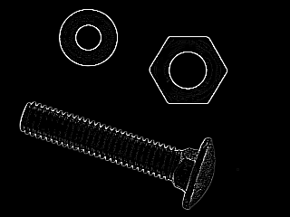
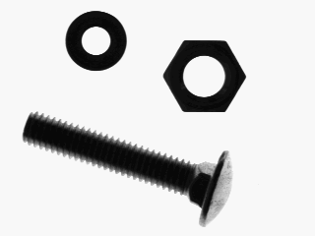
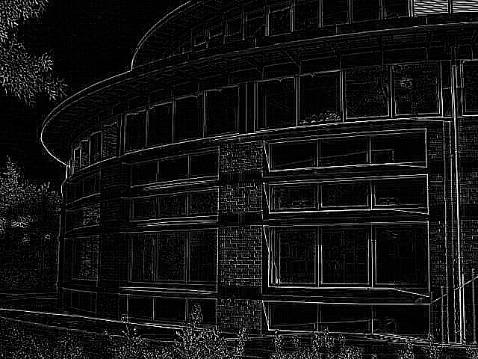
Laplacian (cont.)
0 | 1 | 0
1 | -4 | 1
0 | 1 | 0
0 | -1 | 0
-1 | 4 | -1
0 | -1 | 0
1 | 1 | 1
1 | -8 | 1
1 | 1 | 1

Slide 13
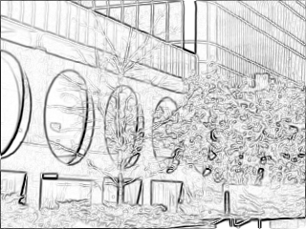
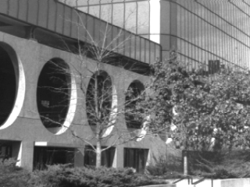
Sobel Edge Enhancement
-1 | 0 | 1
-2 | 0 | 2
-1 | 0 | 1
-1 | -2 | -1
-0 | 0 | 0
1 | 2 | 1
The Sobel filter extracts all of the edges in an image, regardless of direction
It is implemented as the sum of two directional edge enhancement operators

Slide 14
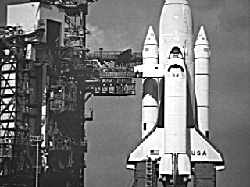
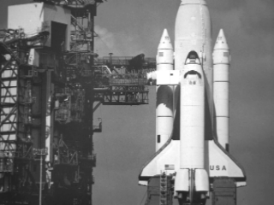
Unsharp Masking
The unsharp masking enhancement operation sharpens an image by subtracting a brightness-scaled, low-pass-filtered image from its original.
A further generalization of unsharp masking is called high-boost filtering:

Slide 15
Shape analysis
Shape measurements are physical dimensional measures that characterize the appearance of an object.
The goal is to use the fewest necessary measures to characterize an object adequately so that it may be unambiguously classified.
The shape may not be entirely reconstructable from the descriptors, but the descriptors for different shapes should be different enough that the shapes can be discriminated.

Slide 16


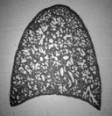

Area
original image
net area
filled area
convex area
The area is the number of pixels in a shape.
The convex area of an object is the area of the convex hull that encloses the object.

Slide 17
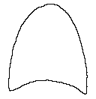
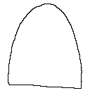
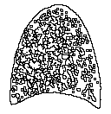
Perimeter
perimeter
external perimeter
convex perimeter
The perimeter [length] is the number of pixels in the boundary of the object.
The convex perimeter of an object is the perimeter of the convex hull that encloses the object.

Slide 18
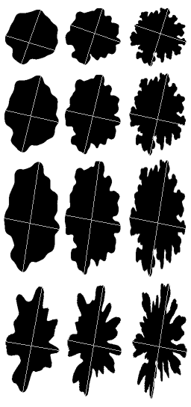
Major and minor axes
The major axis is the (x,y) endpoints of the longest line that can be drawn through the object. The major axis endpoints (x₁,y₁) and (x₂,y₂) are by computing the pixel distance between every combination of border pixels in the object boundary and finding the pair with the maximum length.
The minor axis is the (x,y) endpoints of the longest line that can be drawn through the object whilst remaining perpendicular with the major-axis. The minor axis endpoints (x₁,y₁) and (x₂,y₂) are found by computing the pixel distance between the two border pixel endpoints.

Slide 19
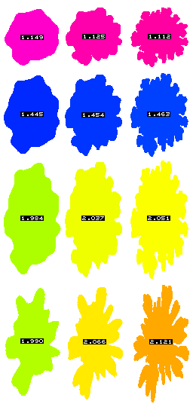
Aspect ratio
The major-axis length of an object is the pixel distance between the major-axis endpoints.
The minor-axis length of an object is the pixel distance between the minor-axis endpoints
The aspect ratio measures the ratio of the objects height to its width:

Slide 20
Compactness (formfactor)
Compactness is defined as the ratio of the area of an object to the area of a circle with the same perimeter:
A circle is used as it is the object with the most compact shape: the measure takes a maximum value of 1 for a circle

Slide 21
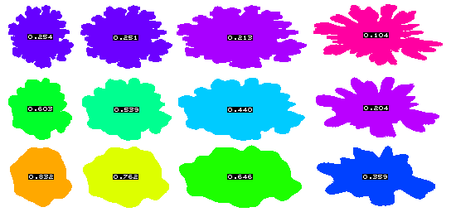
Compactness (cont.)
1

Slide 22
Circularity or roundness
A measure of roundness or circularity (area-to-perimeter ratio) which excludes local irregularities can be obtained as the ratio of the area of an object to the area of a circle with the same convex perimeter:
Roundness equals 1 for a circular object and less than 1 for an object that departs from circularity, except that it is relatively insensitive to irregular boundaries.

Slide 23
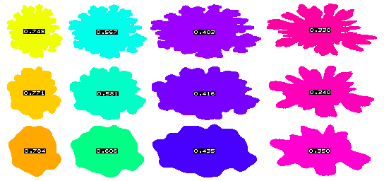
Roundness (cont.)
1

Slide 24
Convexity
Convexity is the relative amount that an object differs from a convex object. A measure of convexity can be obtained by forming the ratio of the perimeter of an object’s convex hull to the perimeter of the object itself:
This will take the value of 1 for a convex object, and will be less than 1 if the object is not convex, such as one having an irregular boundary.

Slide 25
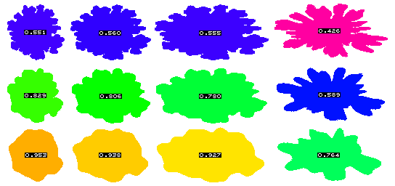
Convexity (cont.)

Slide 26
Solidity
Solidity measures the density of an object. A measure of solidity can be obtained as the ratio of the area of an object to the area of a convex hull of the object:
A value of 1 signifies a solid object, and a value less than 1 will signify an object having an irregular boundary (or containing holes).

Slide 27
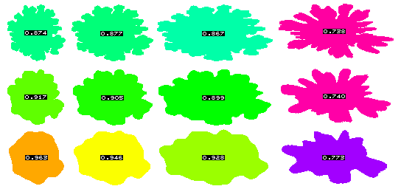
Solidity (cont.)

Slide 28
Moments of shape
The evaluation of moments represents a systematic method of shape analysis.
The most commonly used region attributes are calculated from the three low-order moments.
Knowledge of the low-order moments allows the calculation of the central moments, normalized central moments, and moment invariants.

Slide 29
Calculating the moments
To define the (p,q)^{th}-order moment:
Therefore, we have:
The zeroth-order moment m₀₀ simply represents the sum of the pixels contained in an object and gives a measure of the area.

Slide 30

Centroid
The first-order moments in x (m₁₀) and y (m₀₁) normalized by the area can be used to specify the location of the centre of gravity, or centroid of an object.
Centroid It has two components, denoting the row and column positions of the point of balance of the object:

Slide 31
Central moments
Central moments are defined as moments referred to the centroid of the shape as the origin of the co-ordiate system. They are invariant to translation.
Normalized central moments are invariant to change in size of the shape.

Slide 32
Moment invariants
Normalisation with respect to orientation results in rotationally invariant moments:
From these, we can calculate the following parameters:

Slide 33
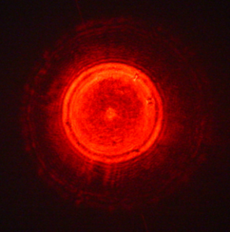
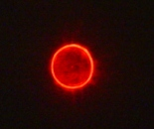
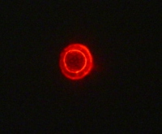
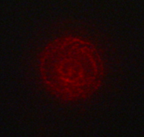
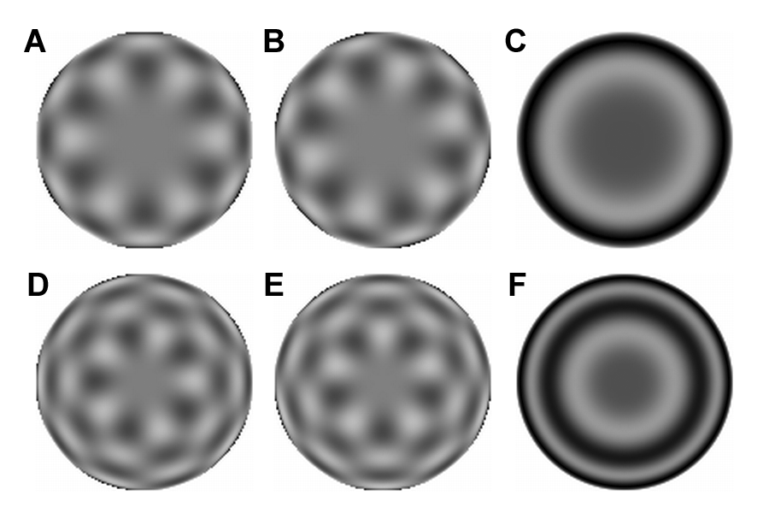
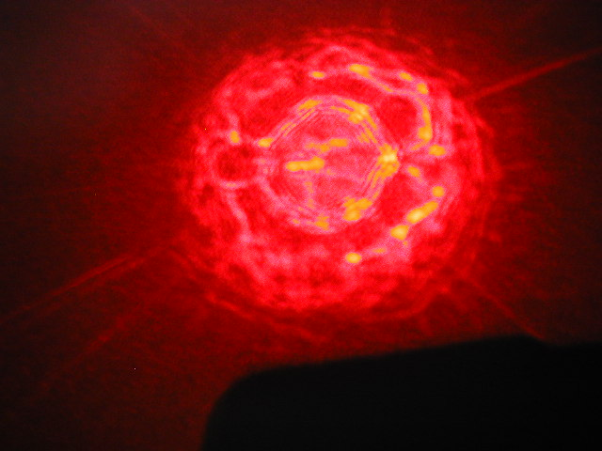
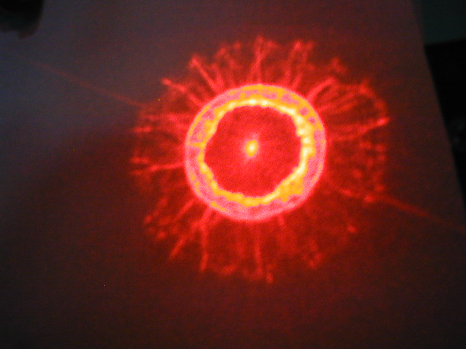
Moments of shape
L. monocytogenes ATCC19113
L. innocua F4248
L. ivanovii ATCC19119
L. seeligeri LA 15
L. welshimeri ATCC35897
L. grayi LM37
Graphical representation of radial Zernike polynomials Z_{n,m} in 2D (image size 128 x 128 pixels), and their magnitudes: A – real part Z_{10,6}; B – imaginary part Z_{10,6}; C – magnitude Z_{10,6}; D – real part Z_{13,5}; E – imaginary part Z_{13,5}; F – magnitude Z_{13,5}. The larger the n-|m| difference, the more oscillations are present in the shape. Features used in this study are the magnitudes of Zernike polynomials. One may note that the values of the magnitudes do not change when arbitrary rotations are applied.
Reference: Bayraktar, B et al, J. Biomed. Opt. 11:34006, 2006

Slide 34
Moments-based measures of shape
Extension (E), dispersion (D) and elongation (L):

Slide 35
Extension
Extension is a measure of how much the shape differs from the circle. It takes value of zero if the shape is circular and increases without limit as the shape become less compact

Slide 36
Dispersion
Dispersion is the minimum extension that can be attained by compressing the shape uniformly. There is a unique axis, the long axis of the shape, along which the shape must be compressed in order to minimize its extension.
Dispersion is invariant to stretching, compressing or shearing the shape in any direction

Slide 37
Elongation
Elongation is the measure how much the shape must be compressed along its long axis in order to minimize the extension
Elongation never take a value of less than zero or greater than extension

Slide 38
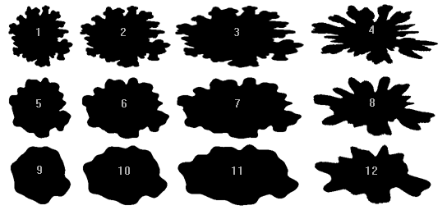
Cell shape

Slide 39
Fiber length
This gives an estimate as to the true length of a threadlike object.
Note that this is an estimate only. The estimate is fairly accurate on threadlike objects with a formfactor that is less than 0.25 and gets worse as the formfactor increases.

Slide 40
Fiber width
This gives an estimate as to the true width of a threadlike object.
Note that this is an estimate only. The estimate is fairly accurate on threadlike objects with a formfactor that is less than 0.25 and gets worse as the formfactor increases.

Slide 41
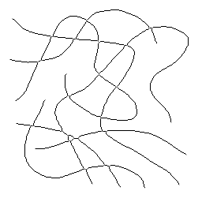
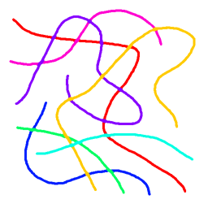
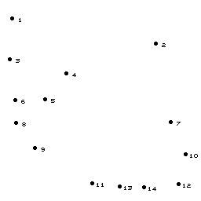
Average fiber length
Picture size =
3.56 in x 3.56 in
Skeletonization
Total length = 29.05 in
Number of
end-points = 14
The number of skeleton end-points estimates the number of fibers (half the number of ends)
Average length:
Length=4.15 in

Slide 42
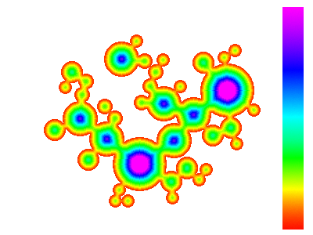

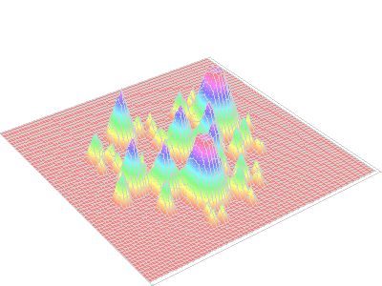
Euclidean distance mapping
Euclidean Distance Map (EDM) converts a binary image to a grey scale image in which pixel value gives the straight-line distance from each originally black pixel within the features to the nearest background (white) pixel.
EDM image can be thresholded to produce erosion, which is both more isotropic and faster than iterative neighbor-based morphological erosion.

Slide 43

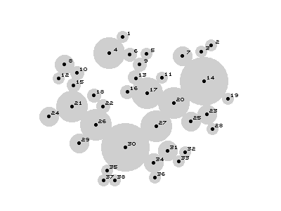
Watershed
The limitation of the watershed approach is that it applies only to features that are slightly overlapped, and which have fundamentally convex shape.
The local maxima in the distance map are the values of inscribed radii of circles that subdivide the image into features.

Slide 44
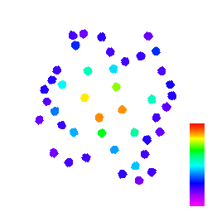

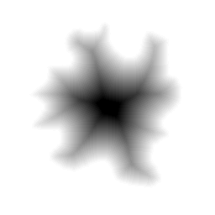
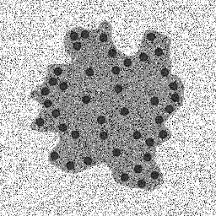
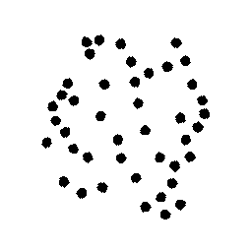
Distance measurements
Threshold
Cutoff
EDM Open
Threshold
Variance
Threshold
Masked result
EDM

Slide 45
Distance… (cont.)

Slide 46
Thresholding
Image thresholding is a segmentation technique which classifies pixels into two categories:
  Those to which some property measured from the image falls below a threshold,
  and those at which the property equals or exceeds a threshold.
Thesholding creates a binary image (binarisation).

Slide 47
Texture segmentation
Texture is a feature used to partition images into regions of interest and to classify those regions.
Texture provides information about the spatial arrangement of colors or intensities in an image.
Texture is characterized by the spatial distribution of intensity levels in a neighborhood.

Slide 48
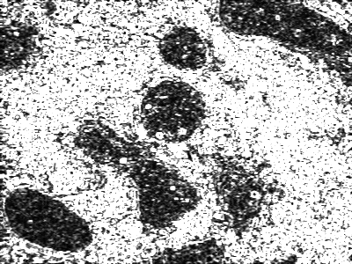
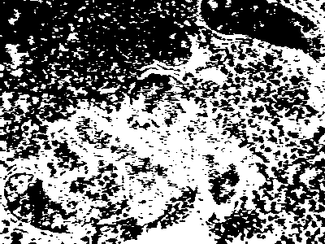
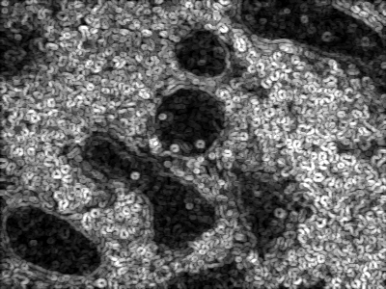
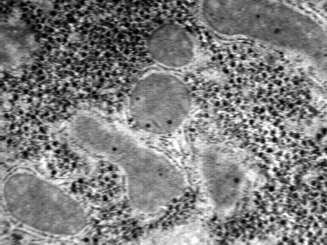
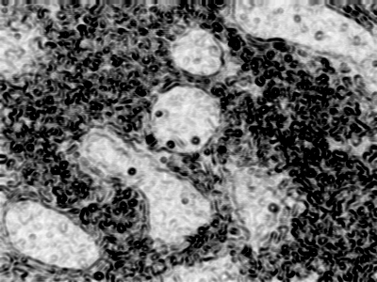
Texture segmentation – an example
thresholding
Texture
filters
range
variance
Haralick entropy

Slide 49
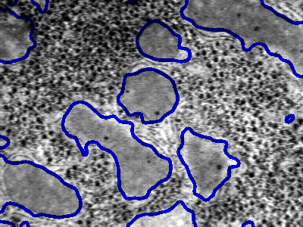
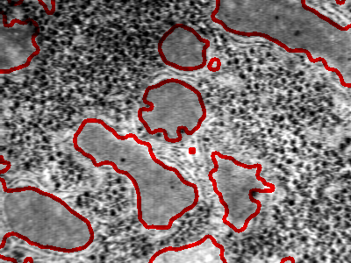
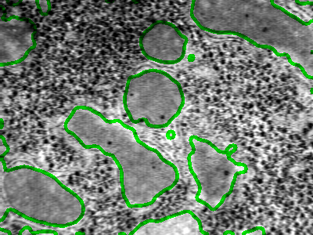
Texture segmentation
range
variance
Haralick entropy
Original
image
Texture
operator
Gaussian
Blur
Threshold
EDM
Open,
Fill holes

Slide 50
Image math
Image arithmetic on grayscale images (addition, subtraction, division, multiplication, minimum, maximum)
Image Boolean arithmetic (AND, OR, Ex-OR, NOT)

Slide 51
AND
The pixel at location (x,y) is 1 if is 1 in both images f₁(x,y) and f₂(x,y):

Slide 52



AND (cont.)
AND
=
So it’s on both…..

Slide 53
OR
The pixel at location (x,y) is 1 if it is 1 in either of the images f₁(x,y) or f₂(x,y):

Slide 54

OR (cont.)
OR
=
So it’s on either…..

Slide 55
XOR
Exclusive OR
The pixel at location (x,y) is 1 if it is 1 in either of the images f₁(x,y) or f₂(x,y), but not if it is 1 in both:

Slide 56

XOR (cont.)
XOR
=
So it’s on not on both…..

Slide 57
NOT
Not requires only a single image
The pixel at location (x,y) becomes 1 if it was 0 and becomes 0 if it was 1:

Slide 58

NOT (cont.)
NOT
=
So it’s just itself…..

Slide 59
Non-linear filters
Non-linear filters are known collectively as order statistic filters or rank filters
How does it work? Let’s combine a list of intensity values in the neighborhood of a given pixel, sort the list into ascending order, then select a value from a particular position in the list to use as the new value for the pixel.

Slide 60
Median filter
Selects the middle-ranked value from a neighborhood. For a n x n neighborhood (kernel), with n odd, the middle value is at position:

Slide 61
Median filter (cont.)
+
Median filter

Slide 62
Periodic Noise
Periodic noise in an image may be removed by editing a 2-dimensional Fourier transform (FFT). A forward FFT of the image below, will allow you to view the periodic noise (center panel) in an image. This noise, as indicated by the white box, may be edited from the image and then an inverse Fourier transform performed to restore the image without the noise (right panel next slide).

Slide 63
Pseudocolor image based upon
gray scale or luminance
Human vision more sensitive to color. Pseudocoloring makes it is possible to see slight variations in gray scales

Slide 64
See previous lecture
Nyquist Theory
To sample or graph a SINE wave you must have at least two points or co-ordinates in order to guess what the frequency is.. For example you need the ORIGIN (y=0 normally) and either a MAXIMUM or a MINIMUM value to guess the frequency. Because of this simple fact, to record a frequency you must have at least double that number as the sampling rate.. EG. To record a sine wave of 50 Hz you need a MINIMUM of 100 samples per second to record the sine wave. This basic fact which governs the minimum sampling rate is called the Nyquist theory. The Nyquist frequency is the highest frequency that you can record with a given sample rate. In the case of a recording with 44,100 samples per second (the sampling rate of CDs) the Nyquist frequency is 22050 Hz. I could go in to drawing pictures to prove this but I wont because you have seen the quality of my drawings above. LOL. The Nyquist theory is not something that you will hear much about but is good to know what it is and how it effects things in real life situations.

Slide 65
Manipulating Images for publication
…we teach you how to manipulate images
….But we also know how to determine if you did cheat!!....
To be expanded in a separate lecture!

Slide 66
Conclusion & Summary
Image Collection
  resolution and physical determinants of collection instrument – collect only what you actually need
Image Processing
  thresholding, noise reduction, filtering, histogram manipulation, etc
Image Analysis
  feature identification, segmentation, value of data, representation of image, extract arithmetic information
Must not exceed an acceptable scientific standard in modification of images
If you cheat and publish, its there for everyone to see…someone smarter than you may dig into your data and expose you!!

